Slide 1
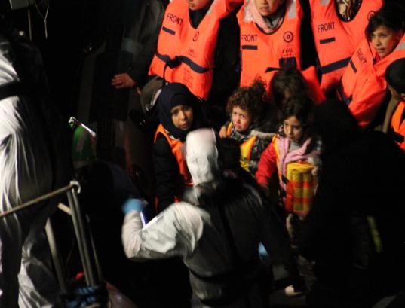
LAWYERS ON THE GROUND RESPONSE TO MIGRANT SMUGGLING Irish Defence Forces Perspective
COMMANDER (NS) Pat BURKE
LEGAL OFFICER NAVAL SERVICE

Slide 2
Outline
Important Caveat – Personal Opinion!
Applying the law in action
‘Interception’ of migrants at sea
Border Control Vs SAR
Disembarkation Issue – Place of Safety
The reality of migrant rescue

Slide 3
Interception Vs SAR
Interception of Migrants on the High Seas - Vagueness of ‘Interception’
Law enforcement?
SAR Vs ‘Engineered SAR’?
UNCLOS - Warships Right of Approach & Visit -flag, piracy, anti-narcotics, etc.
Migrant Smuggling
Differing Legal Regimes

Slide 4
MIGRANT ACTIVITY

Slide 5
Migrant Smuggling
“Migrant smuggling involves procuring a person’s entry into a state of which the person is not a national or a permanent member by crossing borders without complying with national migration law and doing so for financial benefit” The Protocol against the Smuggling of Migrants by Land, Sea and Air – supplementing the UN Convention against Transnational Organized Crime 2000

Slide 6
Migrant Smuggling
“The smuggling of illegal migrants is a highly profitable business in which criminals enjoy low risk of detection and punishment”. UN Office on Drugs and Crime (UNDOC)
Of itself illegal migration is not considered a crime under international law

Slide 7
Relevant Law
National and International Law
Defence Act Ireland – Humanitarian Mission
International Law of the Sea
International Criminal Law
International Humanitarian Law Geneva Convention relating to the status of Refugees - non-refoulement
European Convention on Human Rights

Slide 8
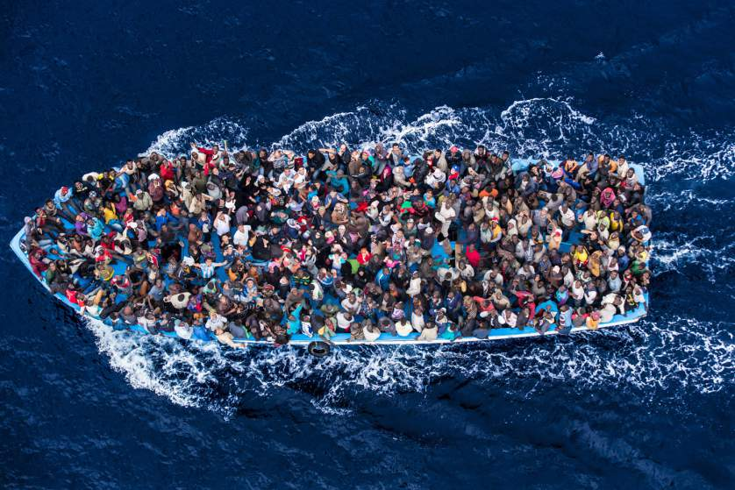
An Outcome of Conflict
200-350 Migrants

Slide 9
Law of the Sea
United Nations Convention on Law of the Sea (UNCLOS) 1982
Int’l Convention on Maritime Search and Rescue (SAR) Treaty 1979
Safety of Life at Sea Convention (SOLAS) 1914
Migrants at sea - UN Convention against Transnational Organized Crime (UNTOC) & Protocols - relevant from an interdiction perspective but NOT from a SAR one

Slide 10
Law of the Sea
Article 98 UNCLOS Duty to render assistance
1. Every State shall require the master of a ship flying its flag, in so far as he can do so without serious danger to the ship, the crew or the passengers:
(a) to render assistance to any person found at sea in danger of being lost
(b) to proceed with all possible speed to the rescue of persons in distress

Slide 11
Law of the Sea
SOLAS 2004 Amdt - Master of a ship is bound to proceed with all due speed to assist in any rescue at sea
The Govt responsible for the SAR region in which assistance is rendered shall ensure that survivors are disembarked and delivered to a place of safety as soon as reasonably practical
Does NOT require disembarkation at the nearest or most convenient place of safety nor the port of the flag State.

Slide 12
Law of the Sea
The provisions of the European Convention on Human Rights are identical in approach to non-refoulement and the European Court of Human Rights has held that this also applies to persons taken on board warships
Warships legally defined in UNCLOS

Slide 13
Asylum Issues
ECtHR ruled on the issue of a rescue on the high seas by an Italian warship - Jamaa Hirsi & Others v Italian Warship (2012)
Italian warship returned rescued Libyan migrants to Libya. Court held obligations to those rescued under Article 3 of the European Convention on Human Rights (ECHR)

Slide 14
Asylum Issues
ECtHR held that returning the rescued migrants to Libya violated the principle of taking them to a safe place, however the Court did not hold that a warship was 'territory' for the purpose of an asylum application
The Court also did not hold that rescued persons should be dealt with by the rescuing Flag State – therefore State where rescued migrants are taken to is responsible

Slide 15
Asylum Issues
The United Nations High Commissioner for Refugees (UNHCR) has directed that it is not possible to process applications for asylum on board a ship
The ‘Dublin Regulation’ provides that in a case of illegal entry to a State the first Member State at which a person seeking international protection arrives is obliged to deal with the application

Slide 16
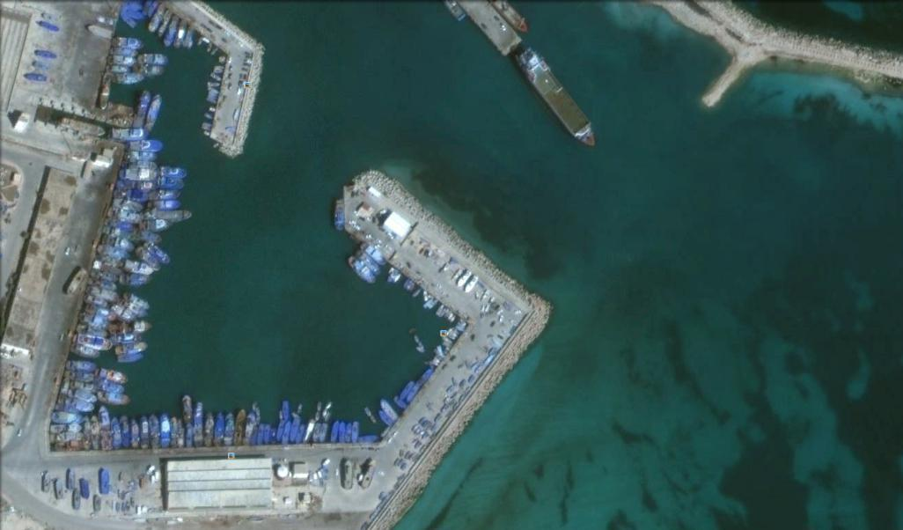
ZUWARAH HARBOUR LIBYA
30% OF THE LIBYAN
MARITIME MIGRATION
FLOW
SABRATHA
TRIPOLI
DARNHA
SIRTE

Slide 17
Irish Navy Deployment
Defence Act Sec 348-humanitarian tasks
IE Note Verbale & IT Note Verbale
OPLAN 1/2015: Op PONTUS
Cooperate & Coordinate with ITN CTG –SAR Only
Once SAR “declared” deal directly IMRCC
Rescued Persons to Place of Safety designated by IMRCC

Slide 18
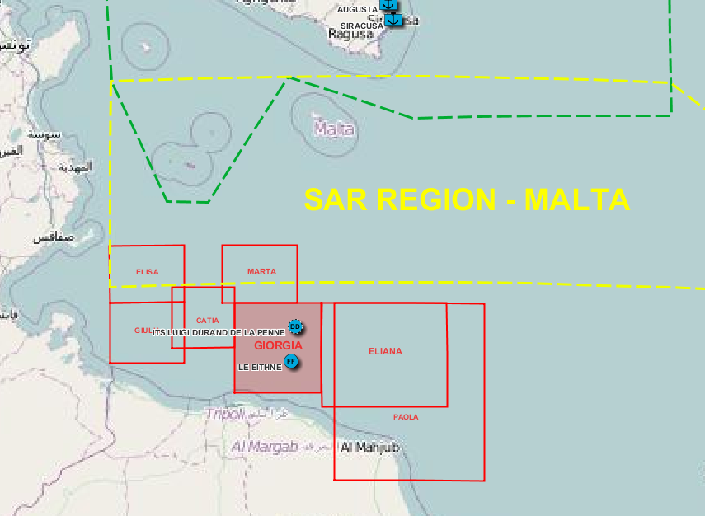
AREA OF OPERATION

Slide 19
‘ENGINEERED’ SAR
Migrants contact IMRCC & use “Key Phrases” to initiate SAR
Boats usually in Libyan SAR zone
IMRCC contact Libya – NO response
IMRCC contact Malta, adjacent SAR zone, unable to react
IMRCC assume responsibility

Slide 23
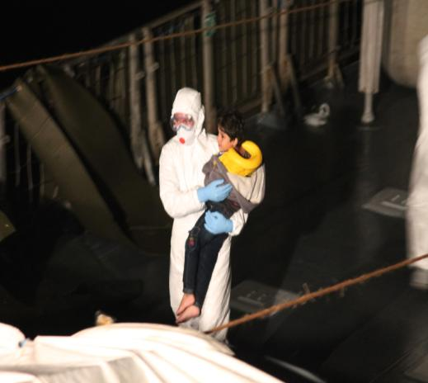
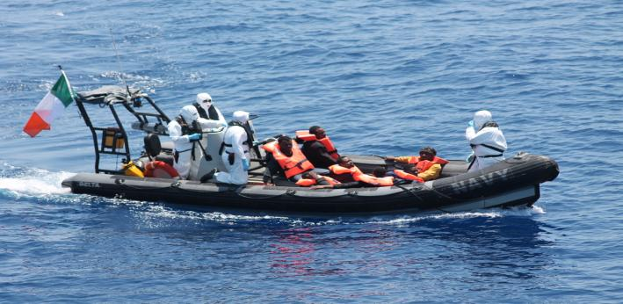
Naval Service Op PONTUS
LE Eithne departed IE 16 May & began
patrolling Sector 23 May 2015
Over 15,000 people rescued to date – ‘Rescued Persons’
The crisis continues………

Slide 24
Naval Service Op PONTUS
Prosecution Witness for Italian Prosecutor Palermo, 19 Dec 2016
Criminal Trial of alleged migrant smugglers

Slide 25
Conclusion
The obligation to render assistance to those in peril or lost at sea is one of the oldest and most deeply routed maritime traditions, and for centuries seafarers have considered it a duty to assist fellow mariners in distress on the high seas
Comprehensive Approach Required

